Slide 1
TMDB Movies
Dataset Analysis

Slide 2
Introduction to TMDB Movies Dataset Analysis
The TMDB Movies Dataset contains detailed information about over 10,000 movies, including: -Revenue, budget, and profit data. -Popularity scores and vote averages. -Genres, release dates, and production companies.
This analysis aims to explore key insights from the dataset, including: -Trends in profitability and return on investment (ROI). -The impact of genres, release months, and popularity on movie success. -Identification of the most successful movies and production companies. By visualizing these relationships, we can better understand the factors that drive movie success in the film industry.

Slide 3
Importing Libraries
numpy & pandas: For data manipulation and
analysis.
matplotlib & seaborn: For creating static
visualizations.
plotly.express: For creating interactive plots.
warnings: Suppresses unnecessary warnings.
Loading the Data
The dataset is loaded from a CSV file using pandas.
TMDB Movies dataset includes movie titles, popularity, revenue, genres, and more.

Slide 4
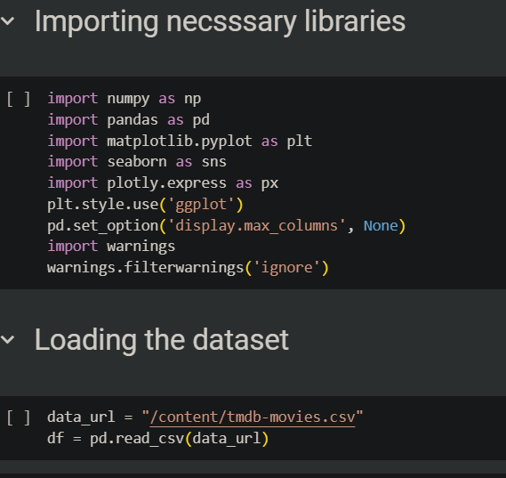

Slide 5
Dataset
Overview
Shape: Displays the number of rows and
columns.
Info: Provides a summary of the dataset (data
types, non-null counts).
Missing Values: Identifies columns with missing
data.
Duplicates: Checks for duplicate rows.
Data
Cleaning
Drop unnecessary columns such as id,
imdb_id, and homepage.
Remove rows with missing values in important
columns like genres and director.
Replace missing values in
production_companies and keywords with 0.

Slide 6
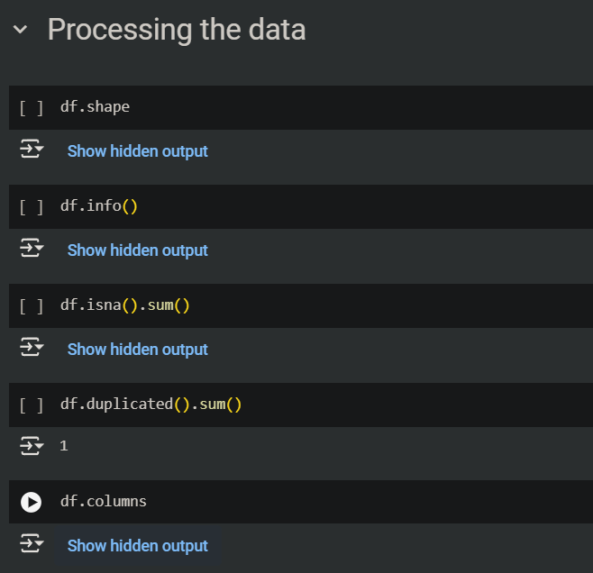
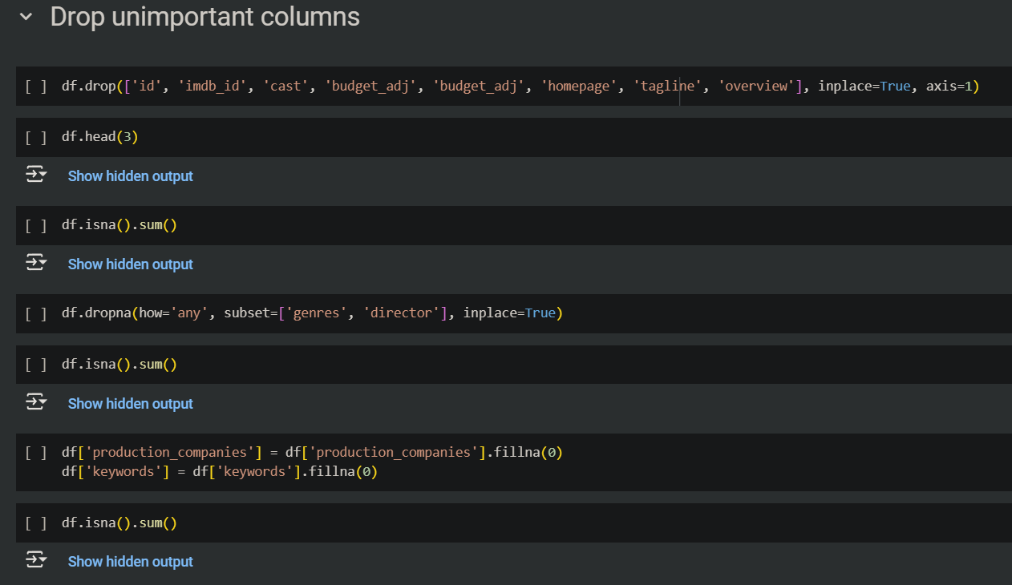

Slide 7
Adding New Features
Profit is calculated as Revenue-Budget.
Return on Investment (ROI) is calculated as
Profit / Budget.
Handling Infinite Values in ROI
Replaces infinite values in the ROI column
with NaN to handle division errors.
Rechecks for missing values in the
dataset.
Distribution of Numerical Columns
Visualizes the distribution of key numerical columns such as popularity, budget, revenue, and vote_average.

Slide 8
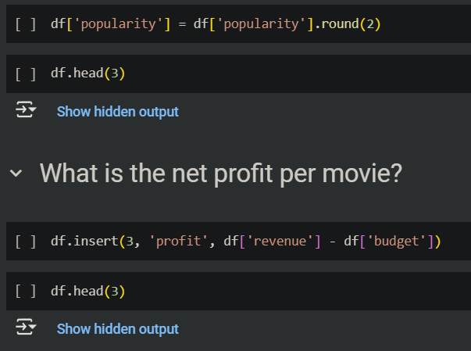
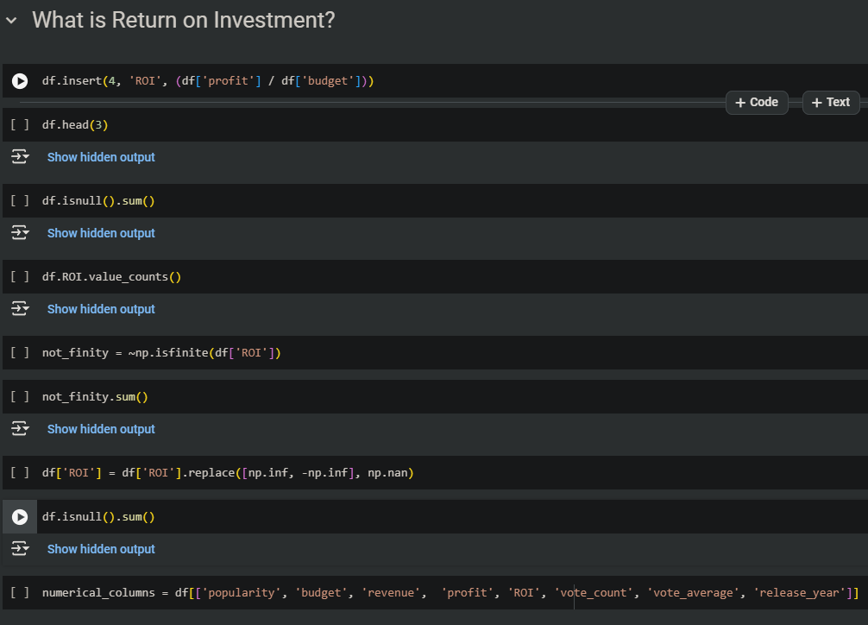
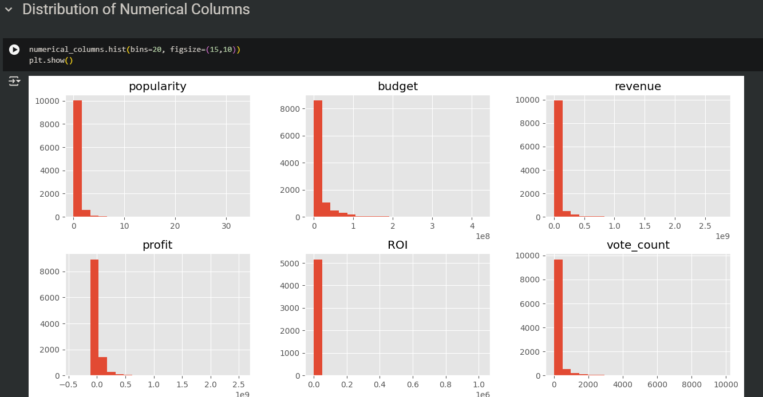

Slide 9
Average ROI by Release Year
Shows how Return on
Investment (ROI)
varies across different
release years.
Popularity by Release Year
Highlights trends in popularity over the
years.
Vote Average by Release Year
Illustrates how average movie
ratings have changed over time.

Slide 10
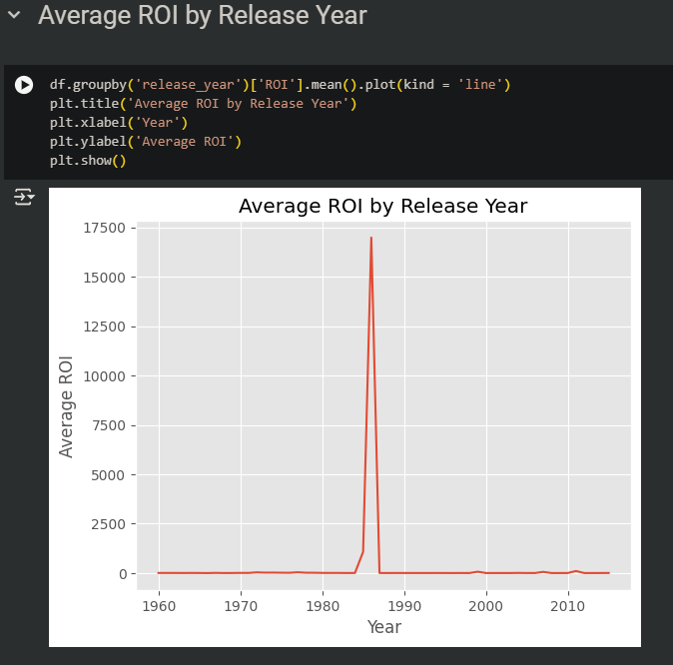
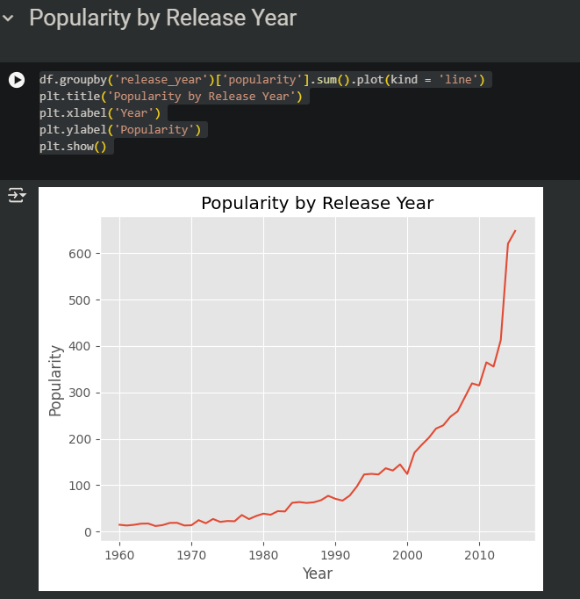
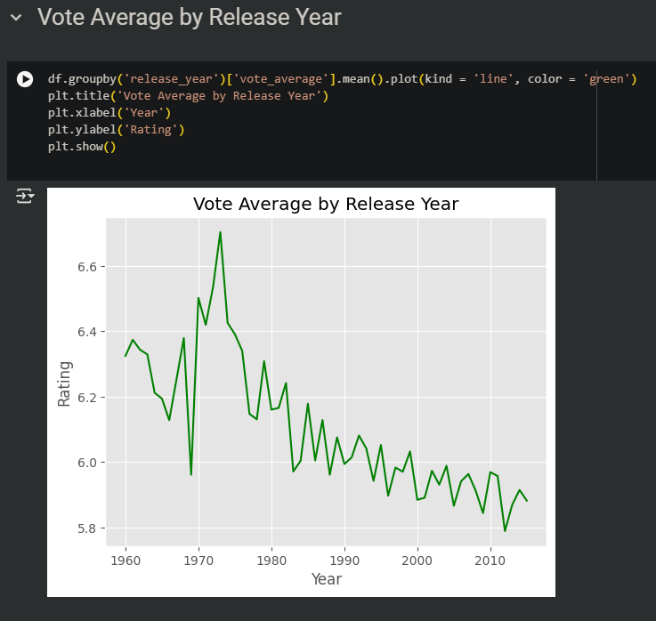

Slide 11
Popularity vs Vote Average
Examines the
relationship between
popularity and vote
average.
Popularity by Genre
Analyzes popularity for each movie genre.
Popularity by Release Month
Visualizes popularity of movies based
on their release month.

Slide 12
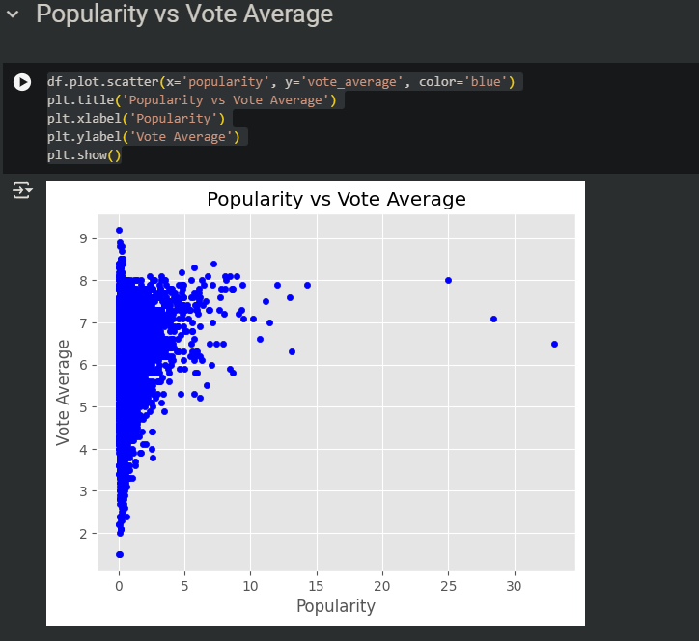
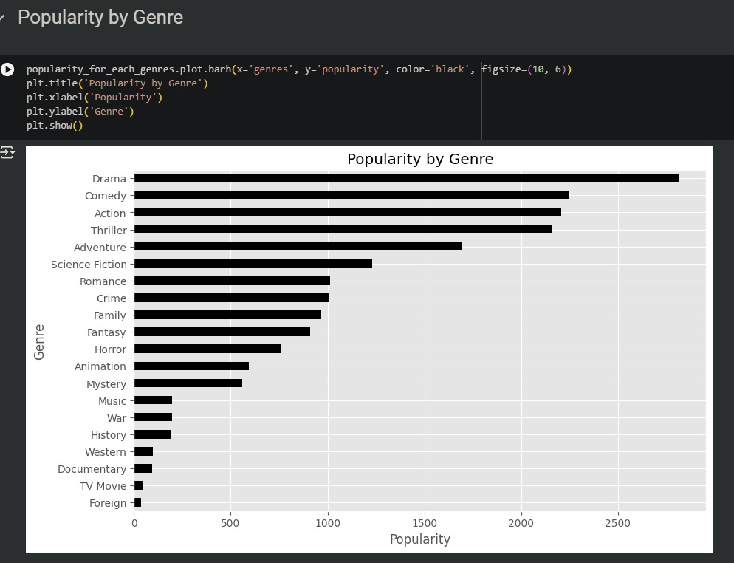
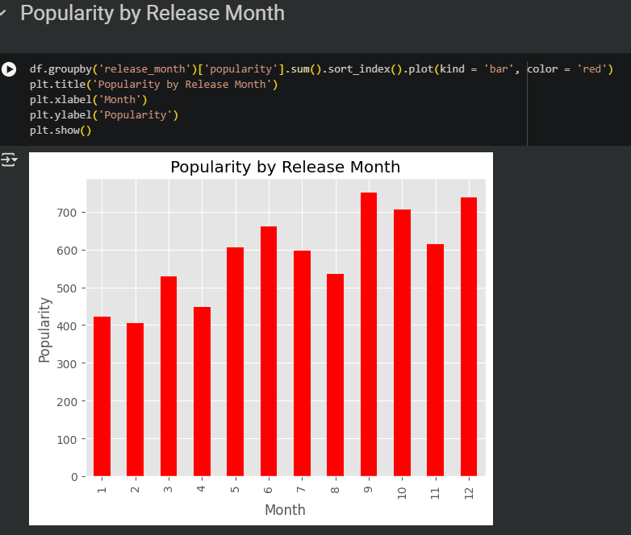

Slide 13
Revenue by Release Month
Shows how revenue changes based on the
release month.
Top 10 Movies by Profit
Displays the top 10 most profitable movies.
Top 10 Movies Production Companies
Explanation: This slide visualizes the top 10 production companies based on their total profit. The production_companies column is first split and exploded to handle multiple companies per movie. The resulting data is then grouped and sorted to identify the top companies.

Slide 14
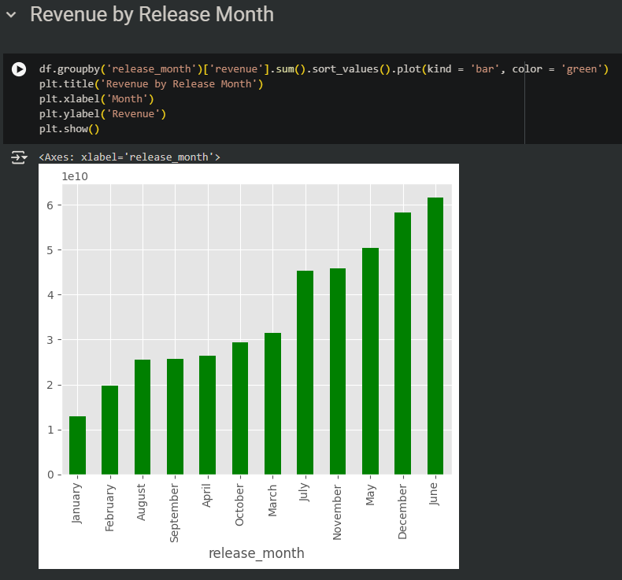
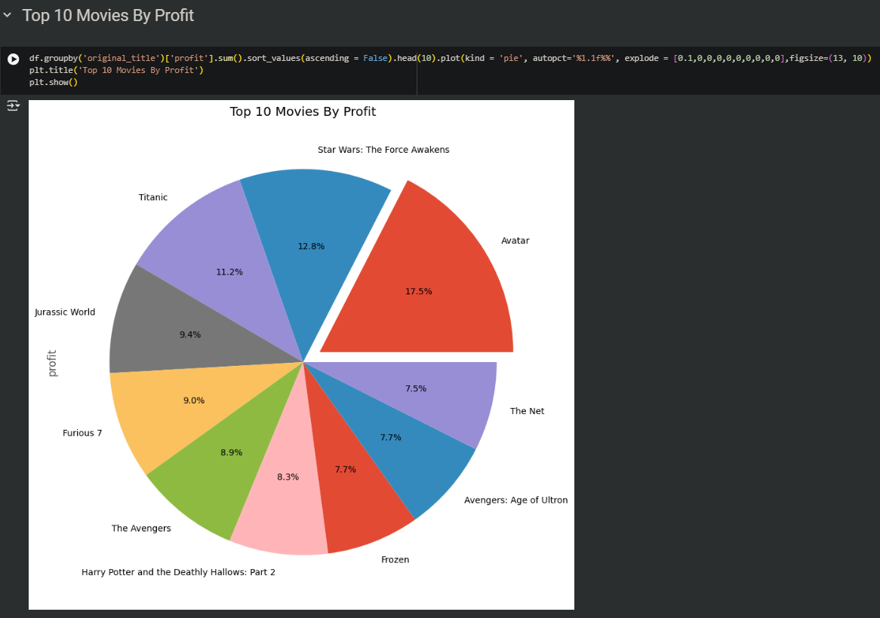
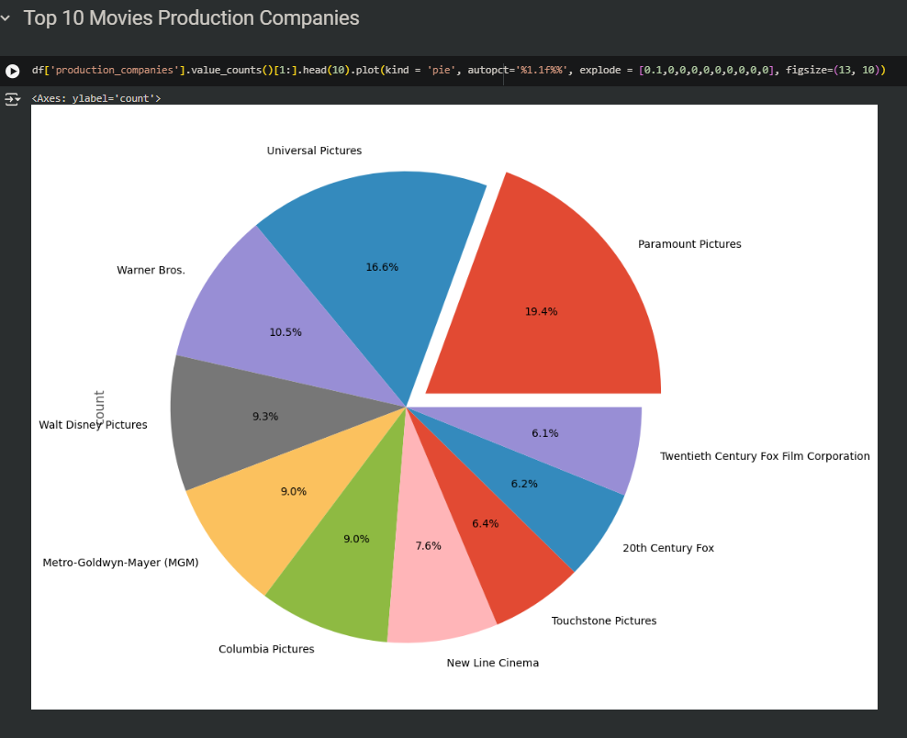

Slide 15
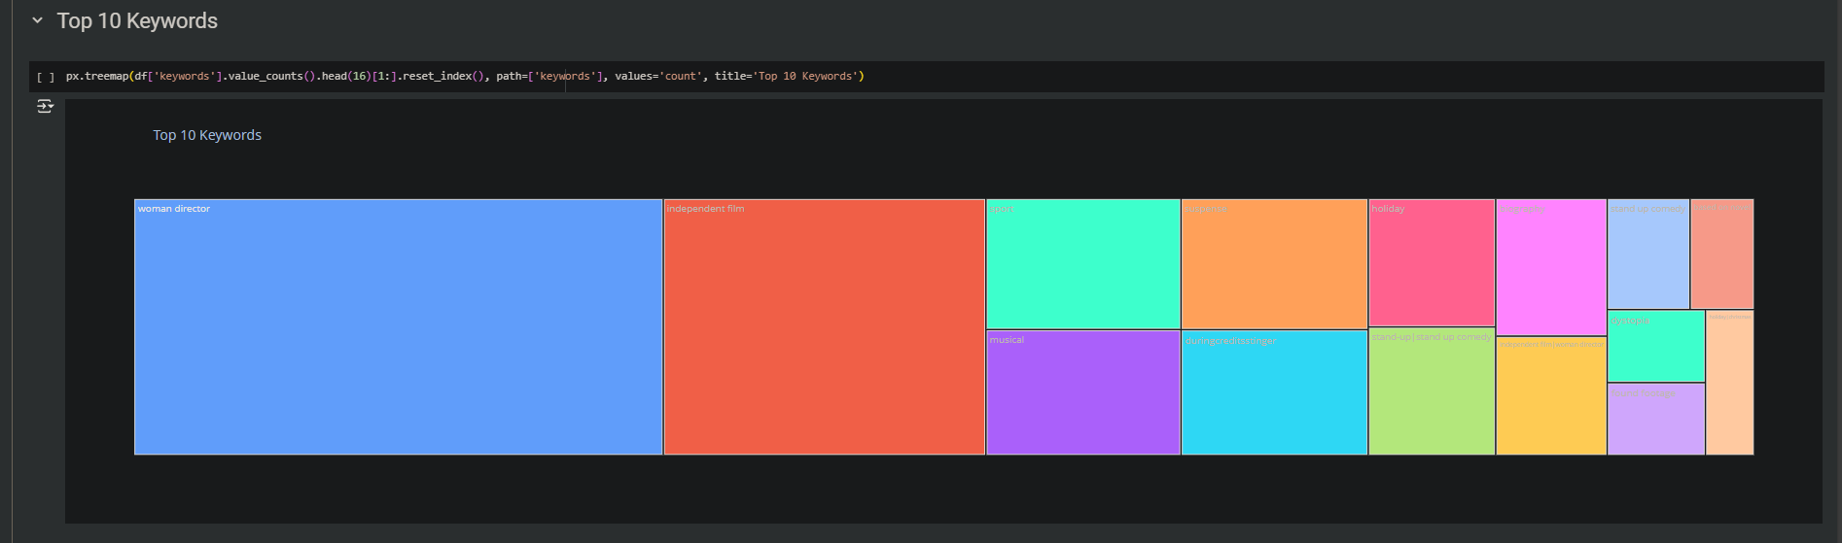
Top 10 Keywords by Popularity
Explanation: This slide shows the top 10 keywords by their summed popularity. Keywords are split and exploded similarly to production companies to allow for accurate aggregation and visualization.

Slide 16
Conclusion and Key Insights
Content: 1-Trends in Profitability and ROI: Profitability and ROI have shown varying trends over the years, with specific periods exhibiting higher returns. 2-Impact of Genres and Release Timing: Certain genres consistently show higher popularity. Movies released in specific months often have better financial outcomes and higher popularity. 3-Top Contributors to Success: The most successful movies often come from a few key production companies. Keywords associated with high popularity can guide future movie themes and marketing strategies. 4-Recommendations: For higher ROI, consider targeting genres and release periods that historically perform well. Analyze popular keywords to better align movie content with audience interests.

Slide 17
Closing Remark
This analysis provides valuable insights into the factors driving movie success. By leveraging these insights, industry professionals can make more informed decisions on movie production, marketing, and release strategies.
Link Project

